Slide 1
Web Crawling
(Domain Discovery)
Craig Knoblock & Pedro Szekely

Slide 2
Topics
Structure of the web
Definitions, applications and requirements
Challenges
Architecture, policies and strategies
Software and tools

Slide 3
Structure Of The Web

Slide 4
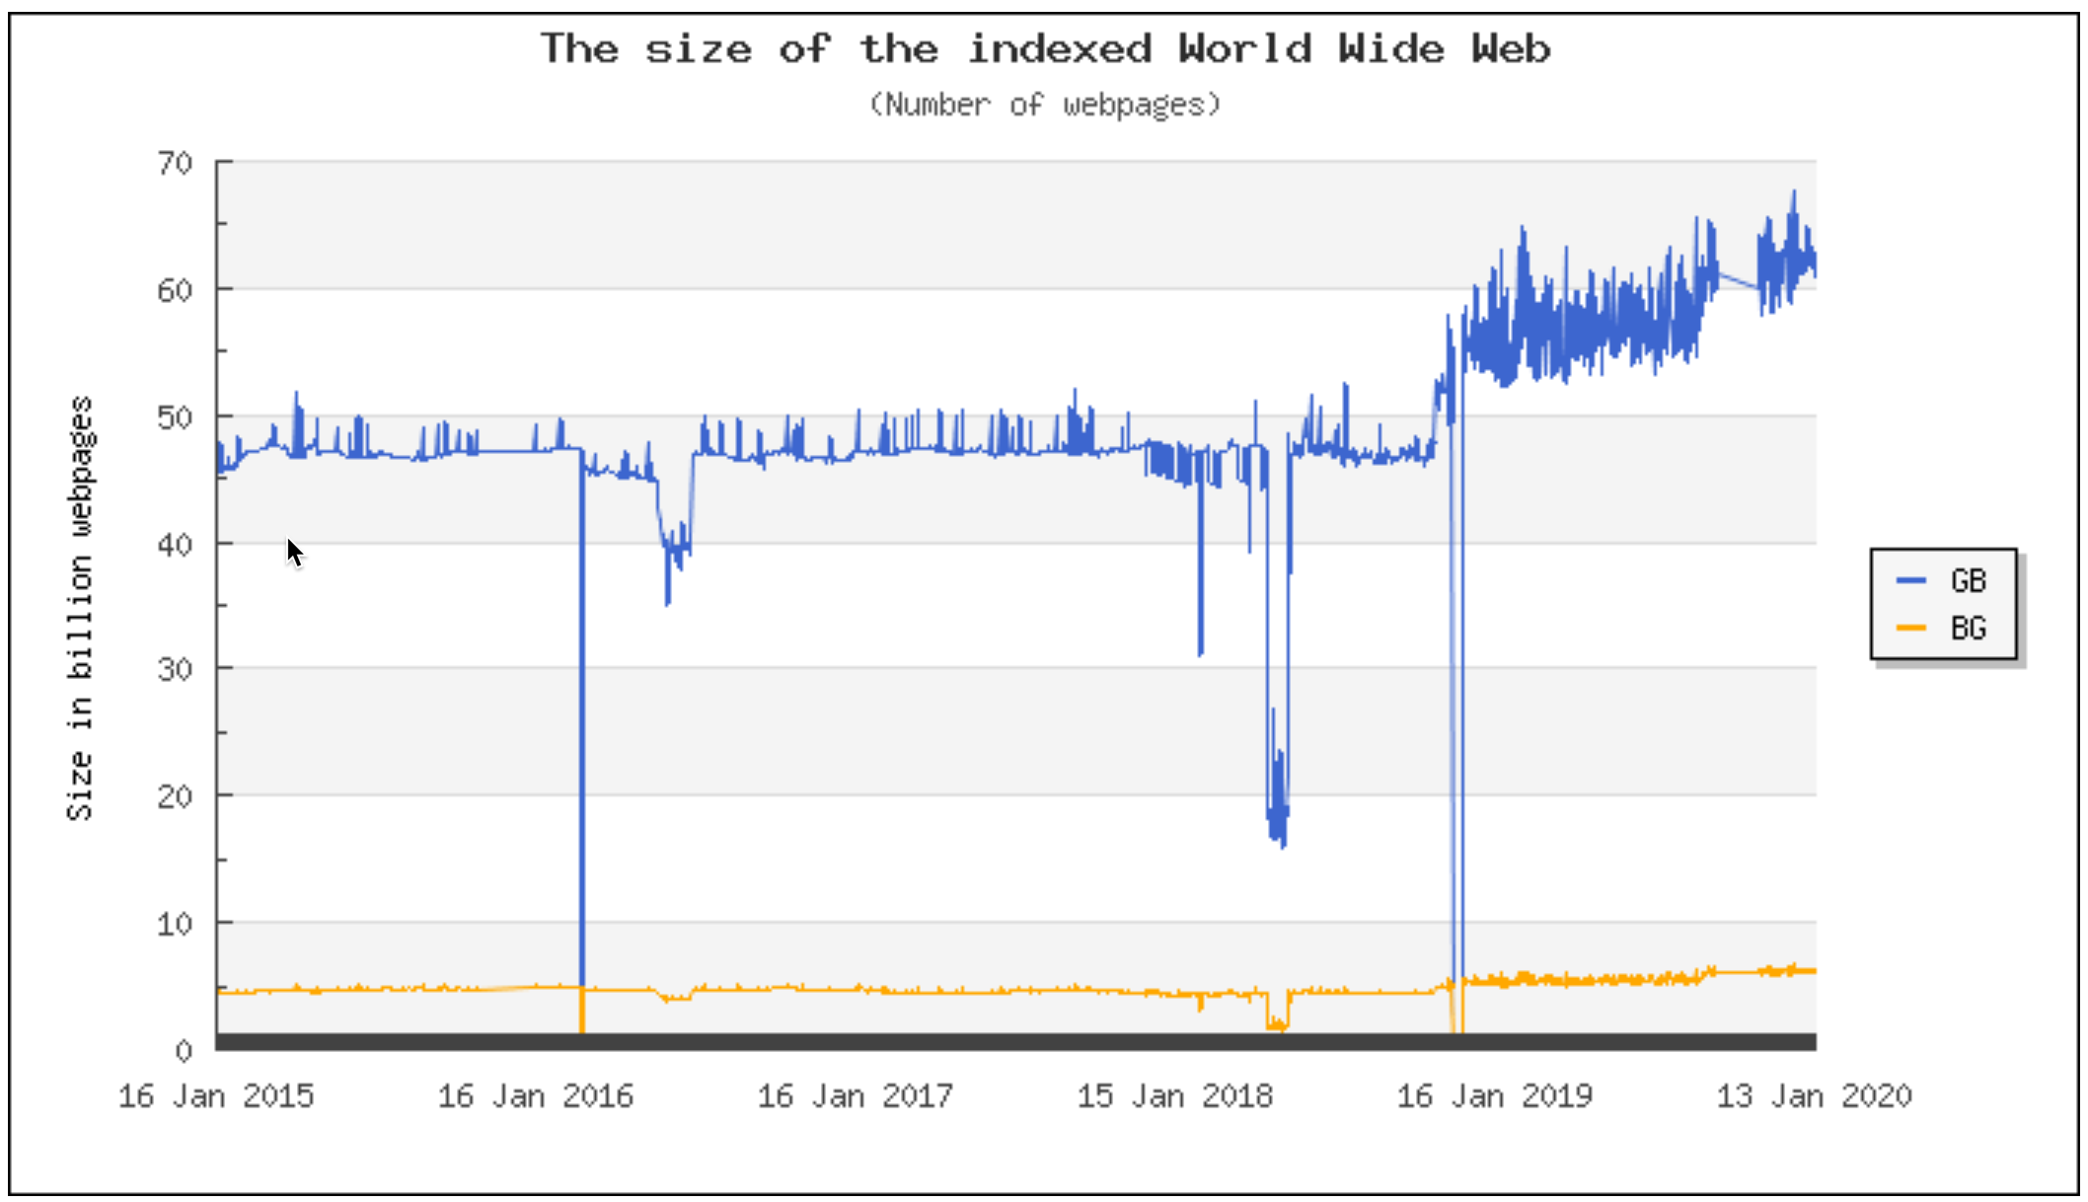
How Big Is the Web?
https://www.worldwidewebsize.com

Slide 5
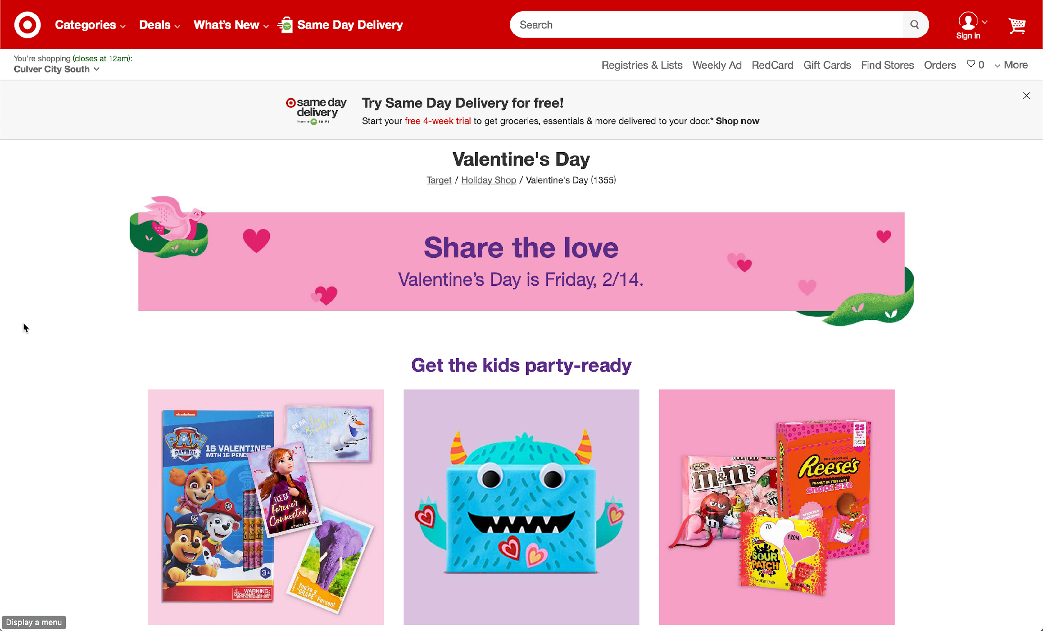
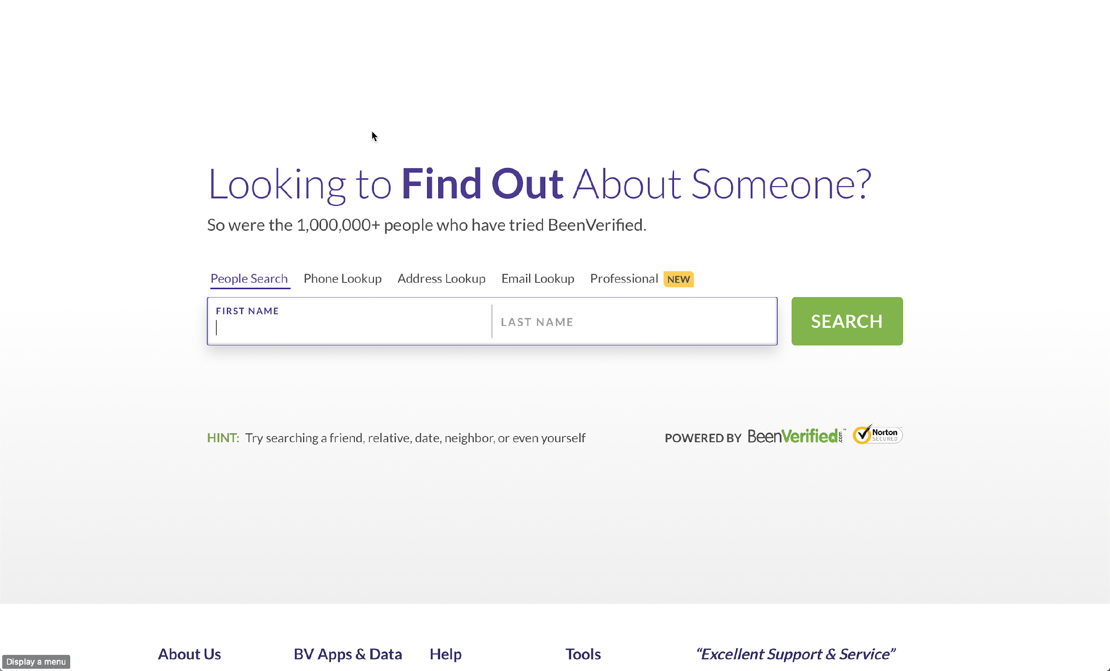
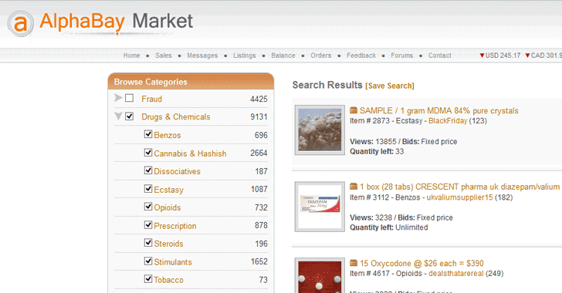
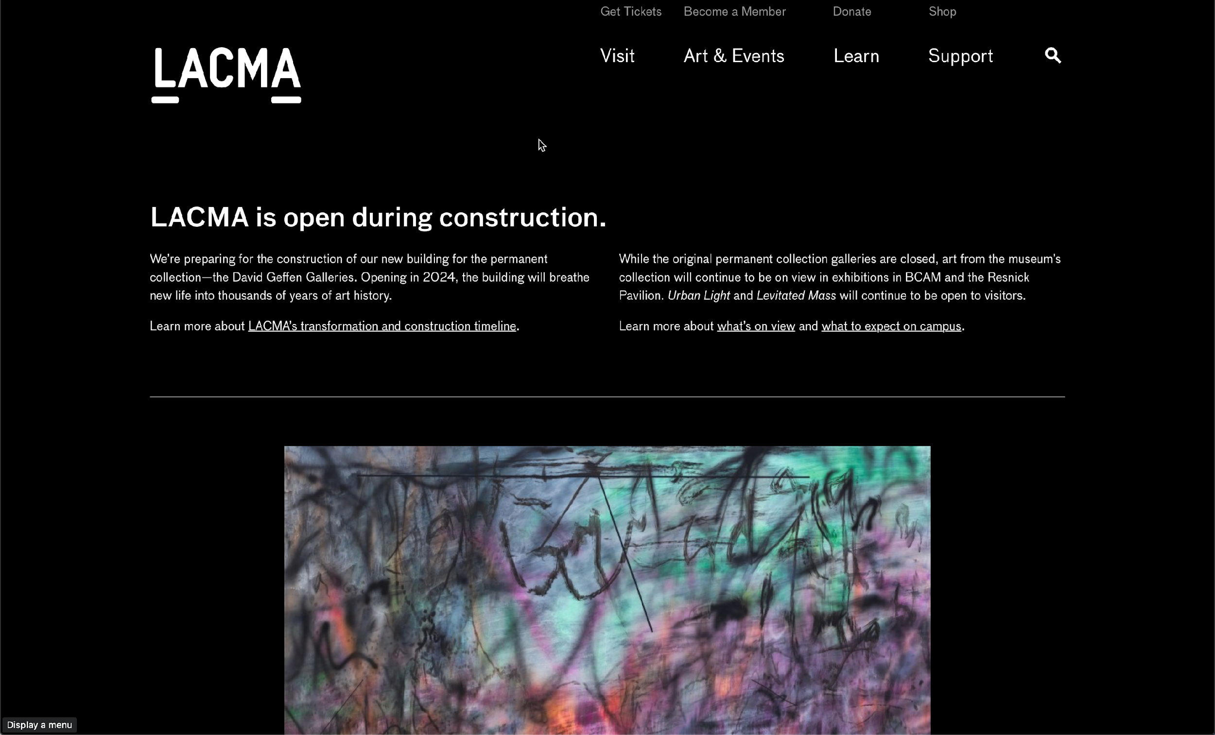
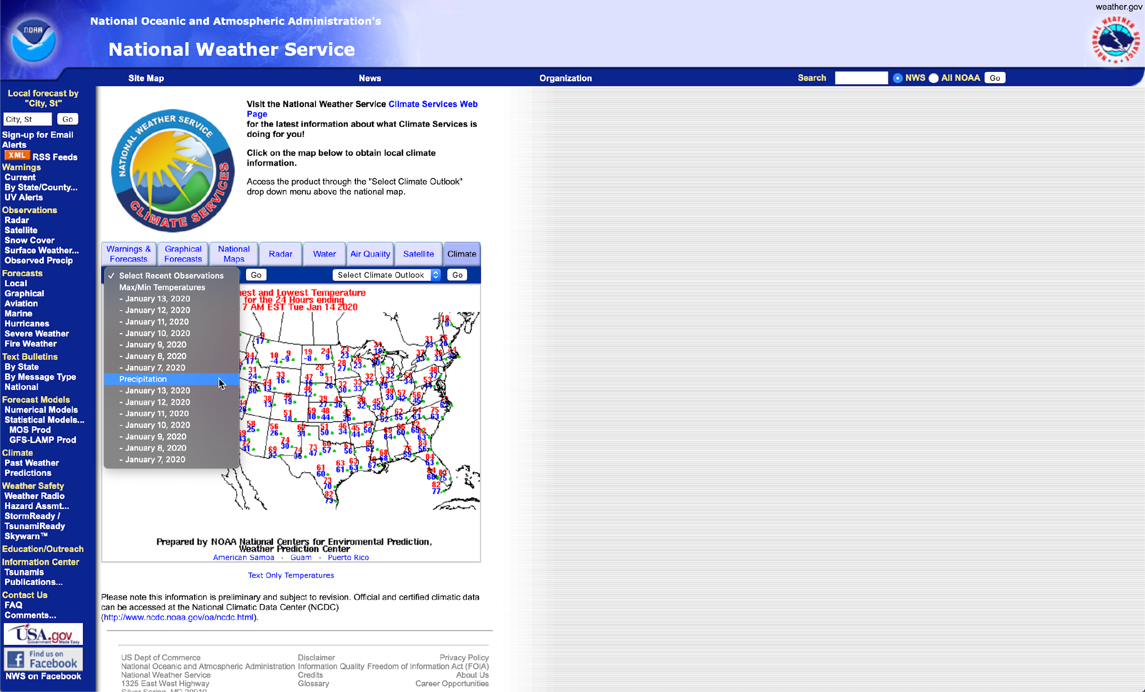
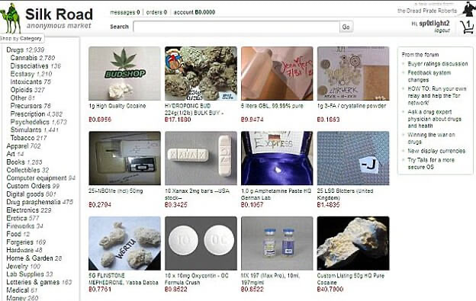
Surface Web Deep Web Dark Web

Slide 6
Surface Web Deep Web Dark Web
Pages reachable by following links from static pages
Pages reachable only via Tor or equivalent
Pages reachable only via web forms

Slide 7
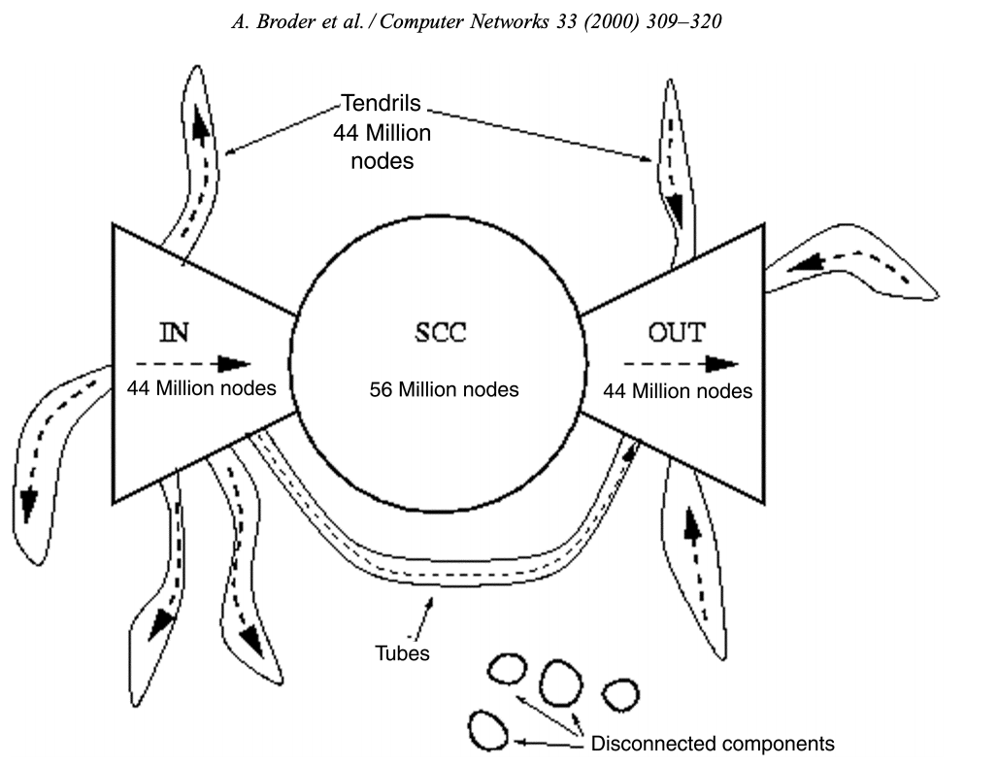
Bowtie Model of the Web
Broder et al. 2000
crawl of 204 million pages and 1.5 billion links
Strongly Connected Component – 27.5%
IN and OUT – 21.5%
Tendrils and tubes – 21.5%
Disconnected – 8%

Slide 8
Definitions, applications and requirements

Slide 9
Web Crawler
Software that automatically browses the web and downloads content

Slide 10
Tim Berners-Lee published the first-ever website in August 6, 1991

Slide 11
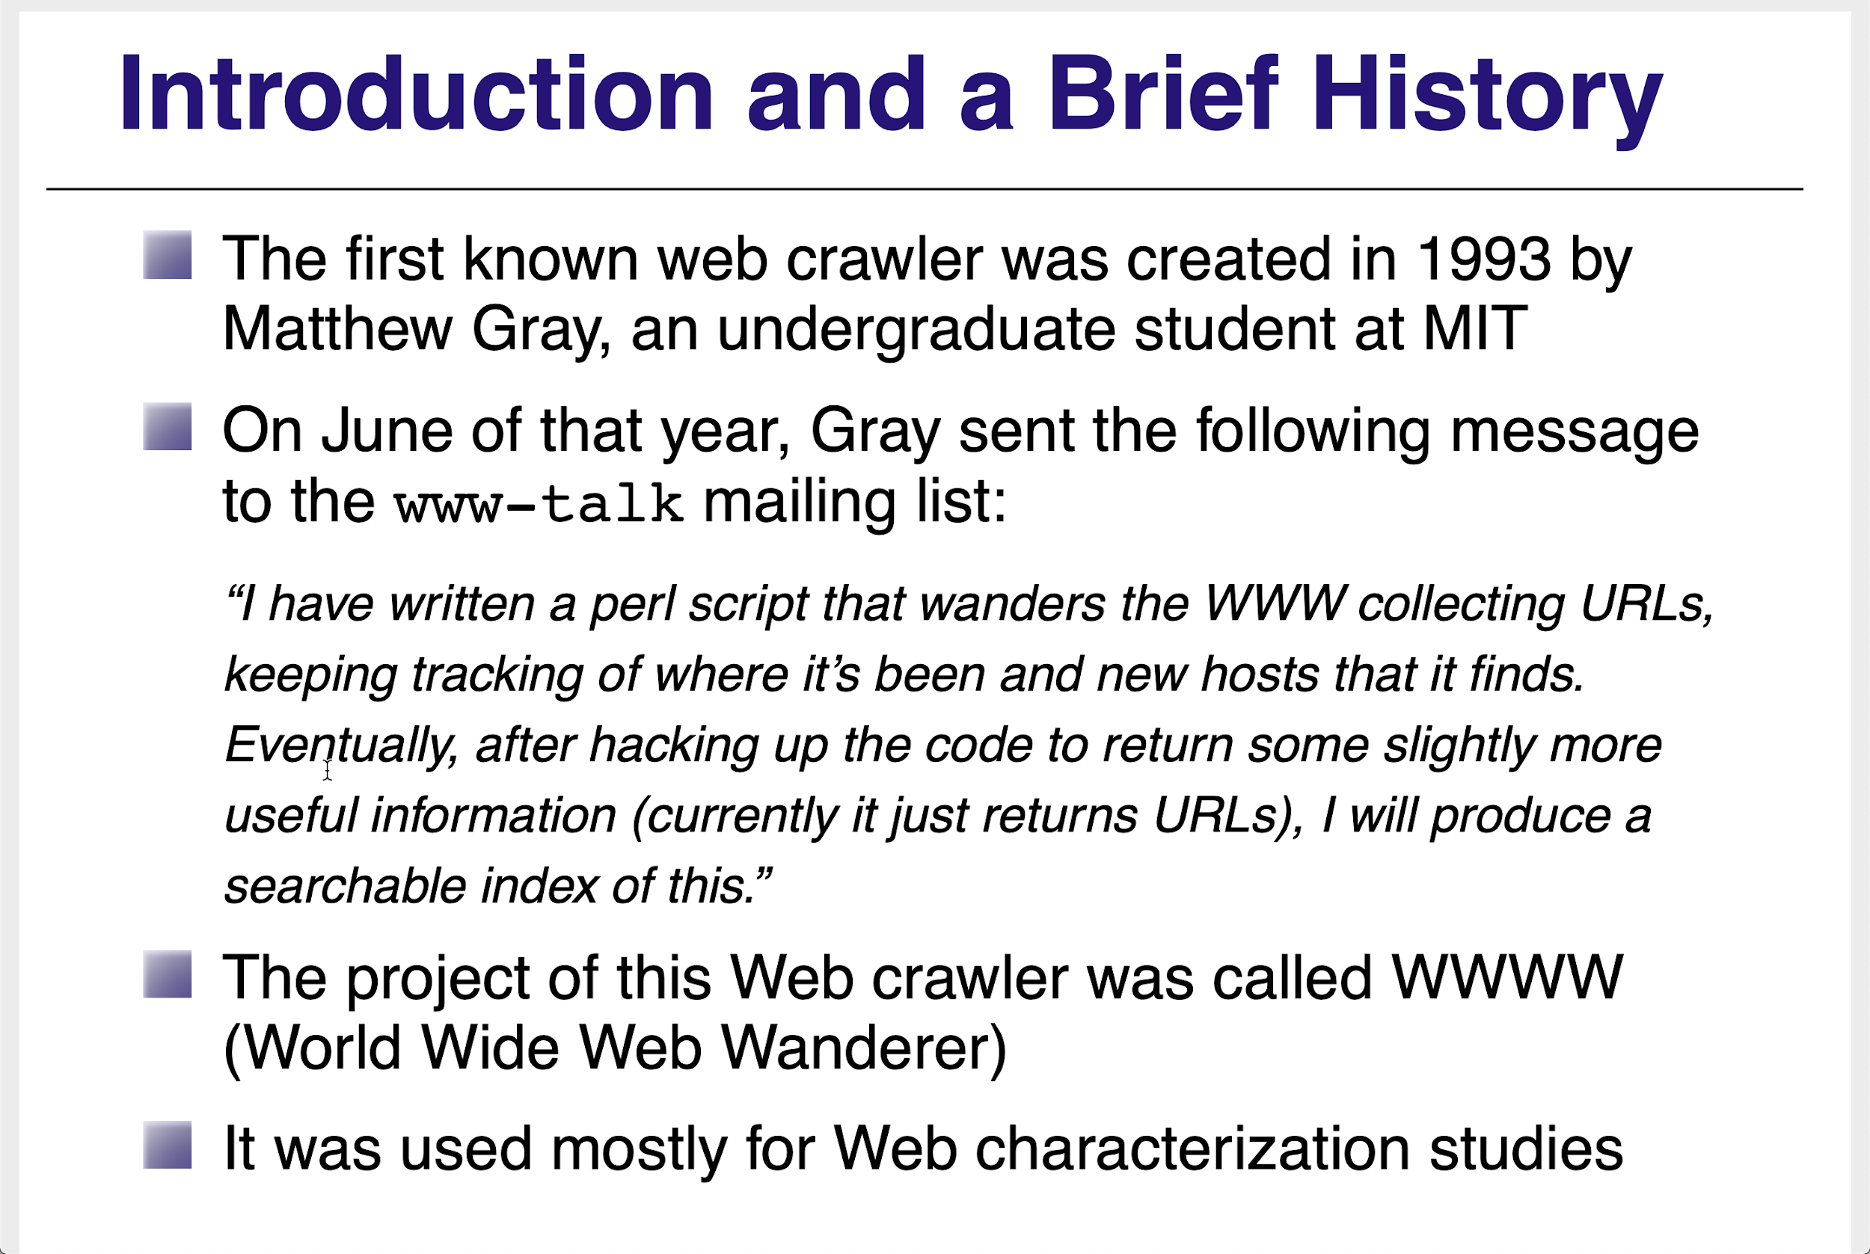
Slide by Carlos Castillo

Slide 12
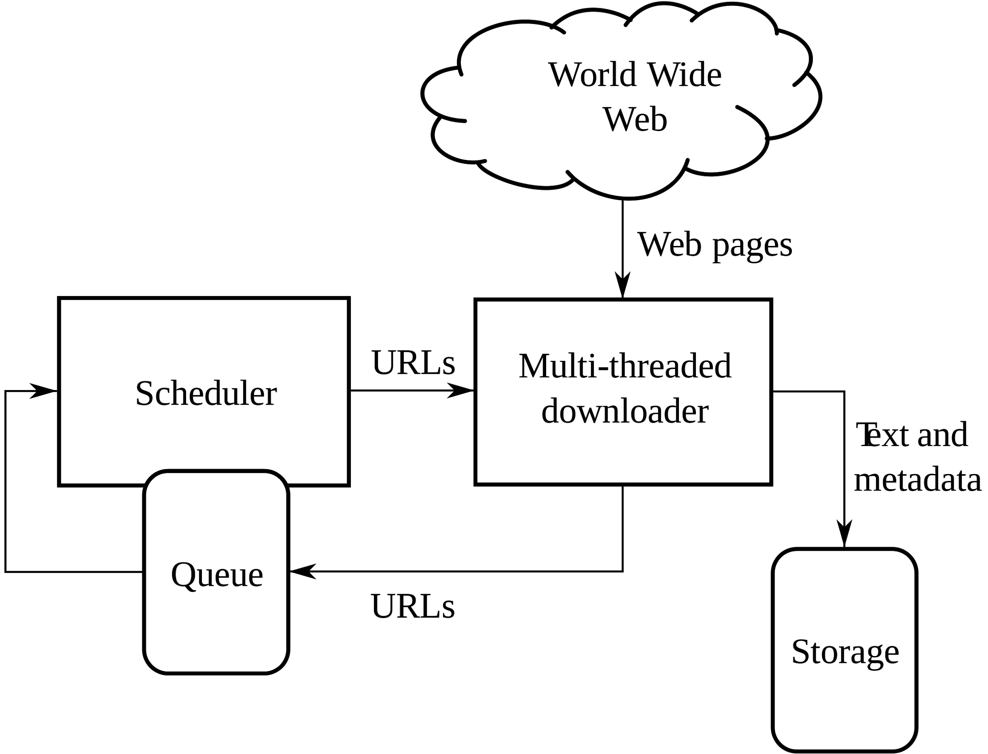
Web Crawler
https://en.wikipedia.org/wiki/File:WebCrawlerArchitecture.svg

Slide 13
Applications
Building search engines
Study the web/internet
Archive the web
Analyze web sites

Slide 14
Applications
Building search engines
Study the web/internet
Archive the web
Analyze web sites
Download content
Text, data, resources (files, images, etc.)

Slide 15
Challenges

Slide 16
Challenges

Slide 17
Challenges
* scale
* deduplication
* cost
* dns
* fetching
* parsing/extracting
* memory/disk
* speed
* errors, redirects
* freshness
* deep web, forms
*counter-crawling/access
* login
* captchas
* traps
* fake errors
* banning
* localization
* dynamic pages
* infinite scrolling
* archiving

Slide 18
Requirements
robustness
bad html
sites are down
politeness
user agent
site-wide
page-specific
robots.txt
noindex, nocache, nofollow
crawl-delay

Slide 19
Architecture, policies and strategies

Slide 21
Where do we start?
URLs
Keywords
Exemplar documents

Slide 22
When do we stop?
Manually
Time limit exceeded
Preset number of documents downloaded
Web site exhausted

Slide 23
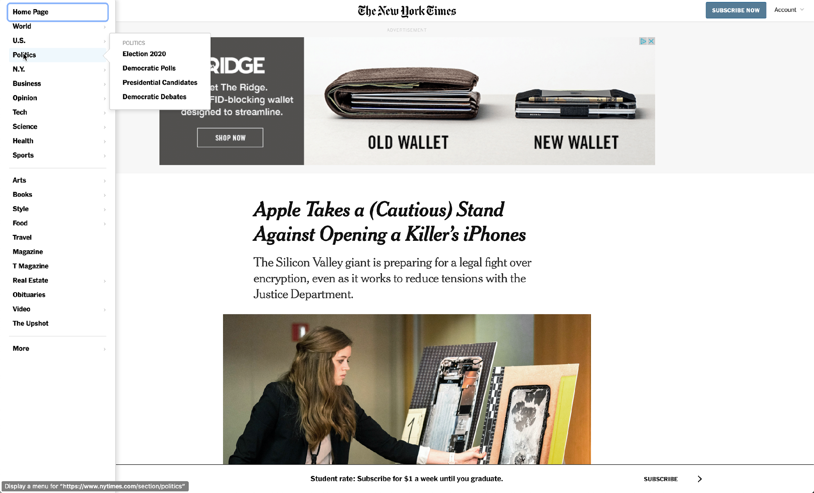
Queue/Scheduler
Queue: one per web site
Scheduler:
breath first
depth first
best first

Slide 24
Which link to follow next?
Priorities often assigned based on their likelihood to lead to relevant pages
Anchor text of page link
Text of page containing the link
Text similarity typically computed using a vector space model
TF/IDF VSM -- term frequencies
Embedding VSM -- continuous vector space

Slide 25
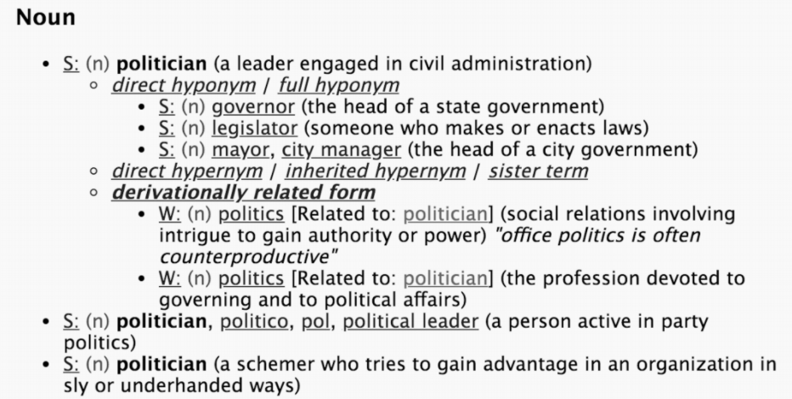
Semantic crawlers
Use taxonomies or ontologies rather than relying on lexical matching or models
example: Wordnet
Define sim(i,j) for
the similarity of
terms

Slide 26
Learning crawlers
Train a classifier with a training set
During crawling, classify each page as either relevant or irrelevant
Learning methods: Naive bayes, decision trees, neural networks, SVMs

Slide 27
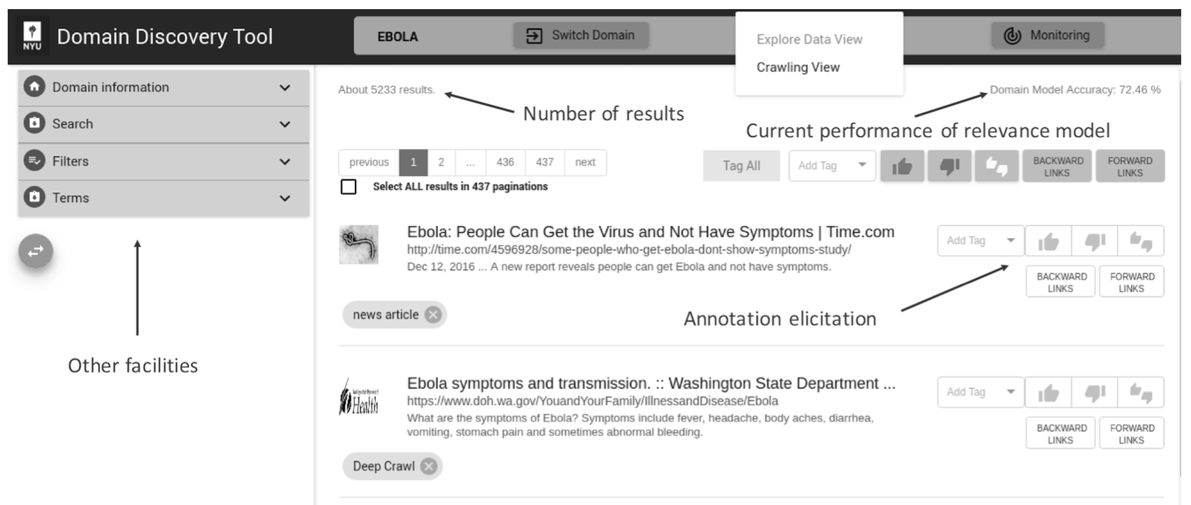
Interface to NYU Domain Discovery Tool

Slide 28
Multithreaded Downloader
Why multithreaded?

Slide 29
Why Multithreaded
Politeness
Spread load on multiple sites
Latency
DNS lookup
Fetching
Parsing
Storing

Slide 30
Download And Then What?

Slide 31
Download And Then What?
Parse
Extract Content
Extract URLs
Add To Queue

Slide 32
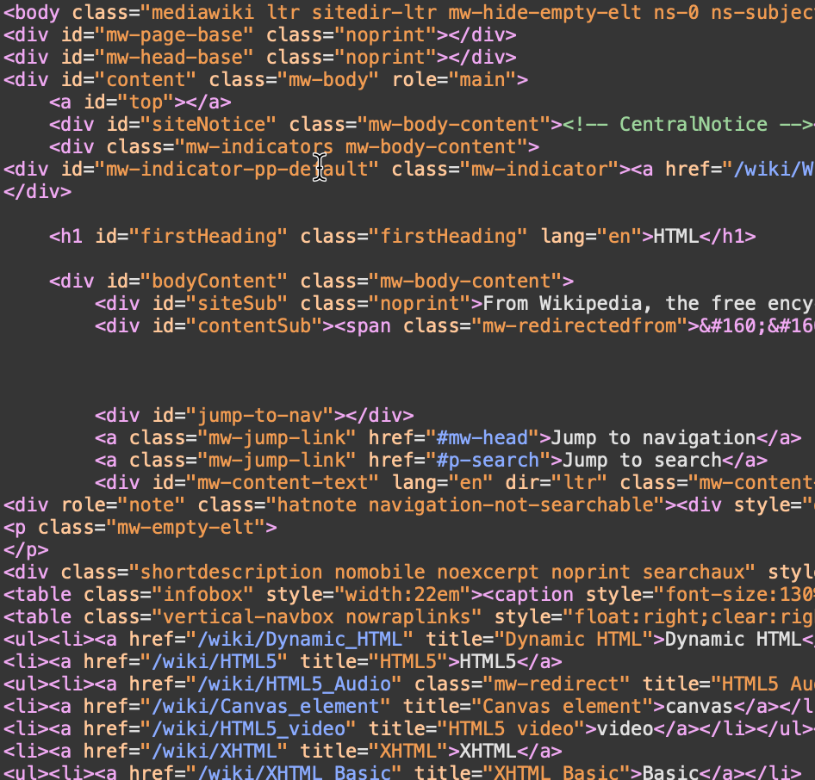
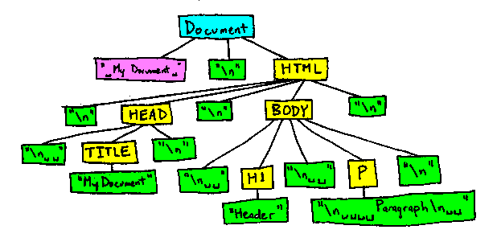
Download And Then What?
Parse
Extract Content
Extract URLs
Add To Queue
HTML
DOM

Slide 33
Download And Then What?
Parse
Extract Content
Extract URLs
Add To Queue
HTML
DOM
Fast/Efficient
Simple
Dynamic pages 😟
Slow 😟
Complex 😟
Dynamic pages

Slide 34
Download And Then What?
Parse
Extract Content ???
Extract URLs
Add To Queue

Slide 35
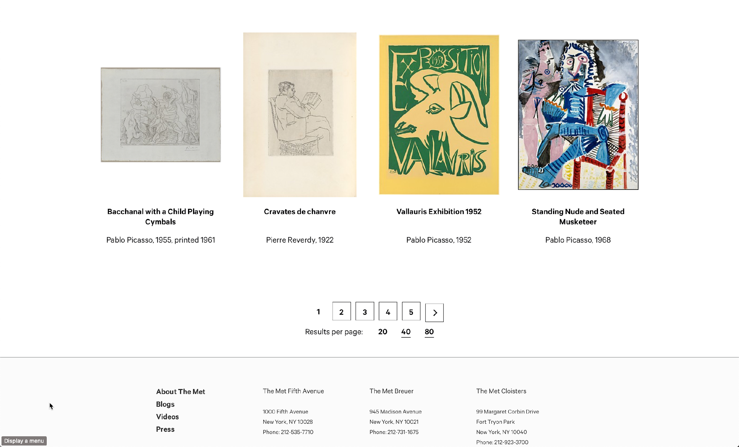
Crawl All Picasso Paintings
extract data
extract URLs

Slide 36
Add To Queue? Is URL Worth Crawling?
Broad crawling
Does URL lead to page worth indexing?
Content extraction
Does URL go to pages with desired content?

Slide 37
Software and tools

Slide 38

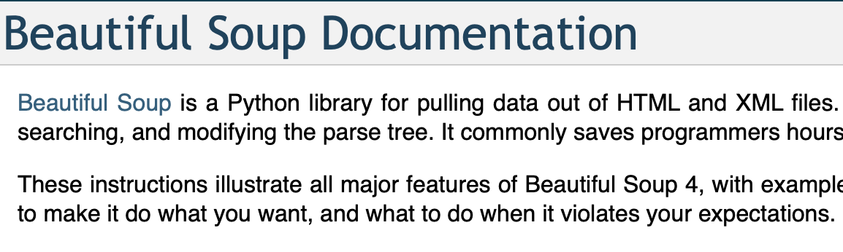
Python Libraries

Slide 39
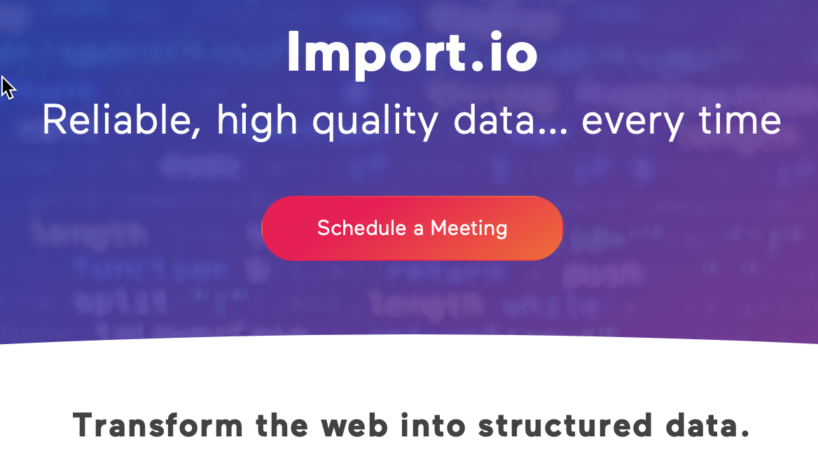

Interactive Tools
https://www.youtube.com/watch?v=QtZbbADRd90
https://www.youtube.com/watch?v=7F7mupSe-w0

